Slide 1
Advanced Computer Graphics
Ray Tracing Project - Project Presentation
Group 5 - Okulmus, Spiss, Mildenberger

Slide 2
Technical Overview
Motion Blur (Okulmus)
Depth of Field (Spiss)
Advanced Texture Mapping (Mildenberger)
Extra Features
Acceleration Structures (Mildenberger)
Camera Control (Spiss)

Slide 3
Motion Blur
First effective solution for Ray Tracing by Cook et al. (1984)
Idea: Distribute rays over time
Implementation: Create Motion by creating multiple “time scene”
Uniformly distribute rays over these scenes
smallPTs super-sampling was extended, no additional rays are created.

Slide 4
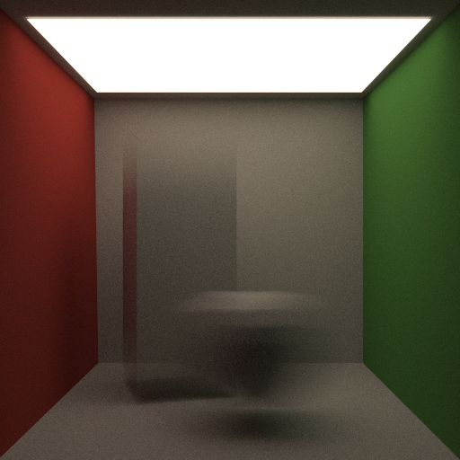
Results Motion Blur
560 spp

Slide 5
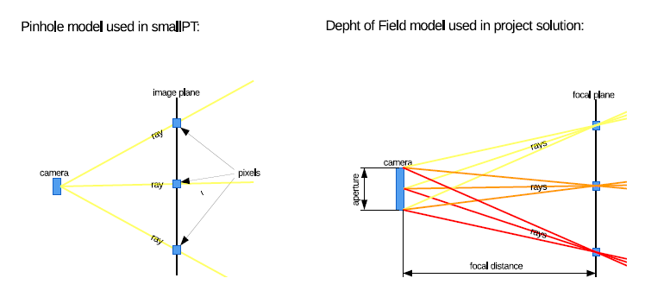
Depth of Field
smallPT uses pinhole camera model → all objects in focus
Thin-Lens camera model is more realistic → a focal point exists
Only objects on focal plane are in focus, everything else is blurred

Slide 6
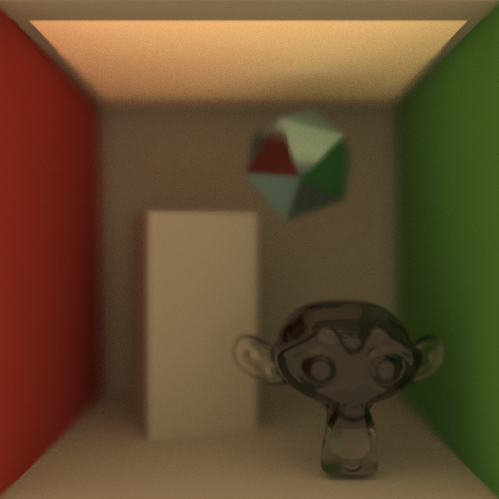
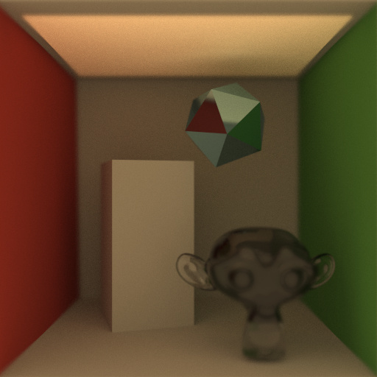
Depth of Field Result
1096 spp
1000 spp

Slide 7
Advanced Texture Mapping
smallPT only allows uniform colour and reflection types (perfectly glossy, everywhere)
New mapping methods:
Normal mapping allows normal transformation for every surface location
Texture mapping supplies colour information
Specular mapping defines the roughness of the surface (diffuse → mirror)

Slide 8
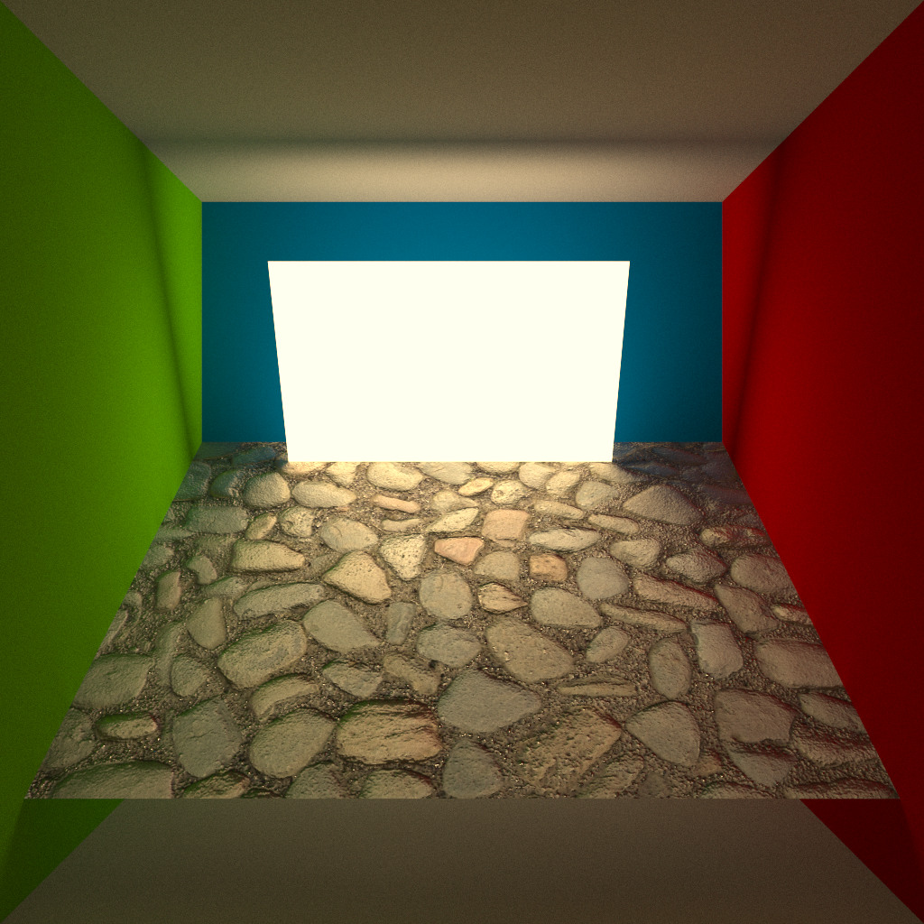
ATM Result
1000 spp

Slide 9
Extra Feature: Acceleration Structure
Raytracing without acceleration techniques is very slow and inefficient
Acceleration structures allow faster mesh intersection by reducing unneeded checks
Implemented structures:
Bounding Boxes : Only one box for every object
Bounding Volume Hierarchy: Octree of Bounding Boxes: From complete scene down to each triangle

Slide 10
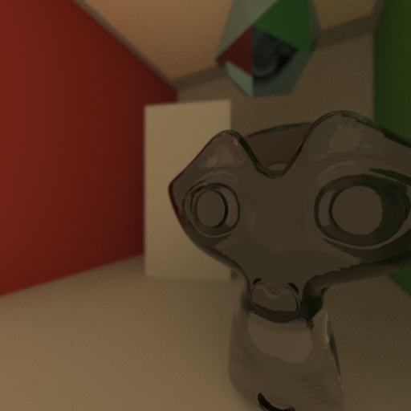
Extra Feature: Camera Control
smallPT only has fixed camera position
Our implementation allows easy change of:
Camera position
Camera direction
Field of view
Focal distance
Example :
1000 spp

Slide 11
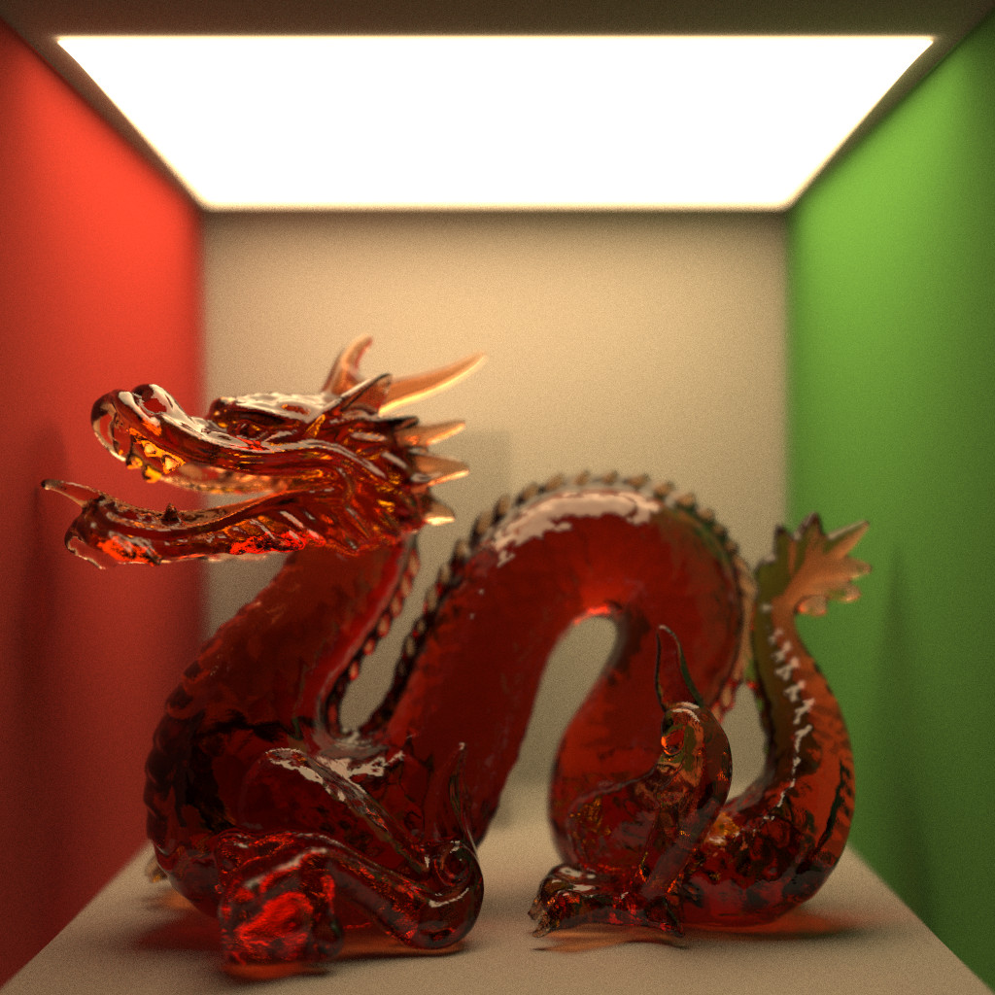
Thanks for listening
1024 spp

